Slide 1
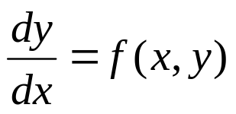
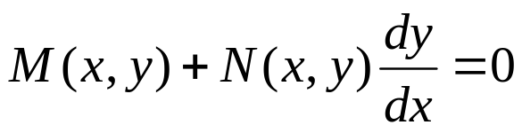


Ch 2.2: Separable Equations
In this section we examine a subclass of linear and nonlinear first order equations. Consider the first order equation
We can rewrite this in the form
For example, let M(x,y) = - f (x,y) and N (x,y) = 1. There may be other ways as well. In differential form,
If M is a function of x only and N is a function of y only, then
In this case, the equation is called separable.

Slide 2
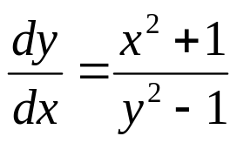
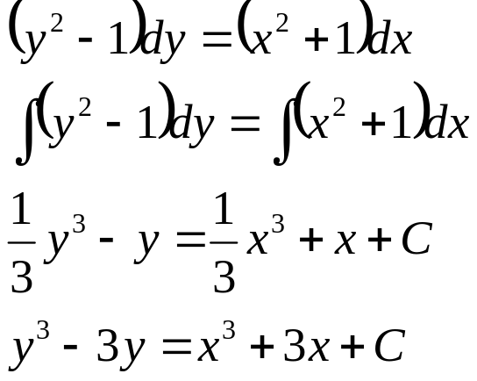
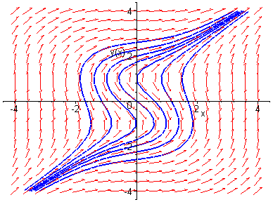
Example 1: Solving a Separable Equation
Solve the following first order nonlinear equation:
Separating variables, and using calculus, we obtain
The equation above defines the solution y implicitly. A graph showing the direction field and implicit plots of several integral curves for the differential equation is given above.

Slide 3
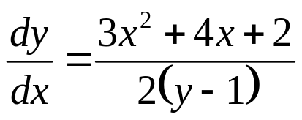
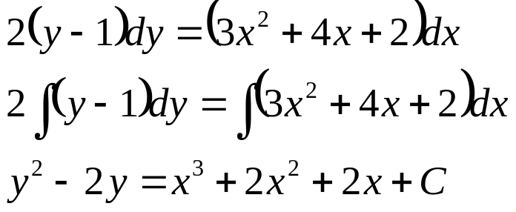
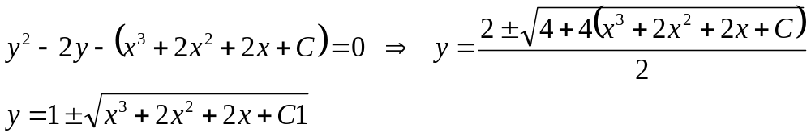
Example 2:
Implicit and Explicit Solutions (1 of 4)
Solve the following first order nonlinear equation:
Separating variables and using calculus, we obtain
The equation above defines the solution y implicitly. An explicit expression for the solution can be found in this case:

Slide 4
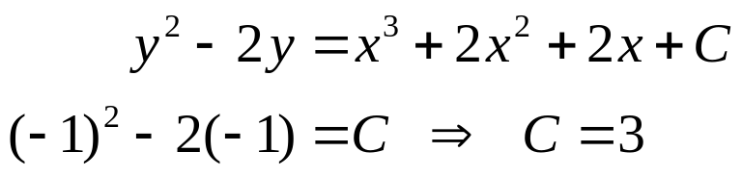

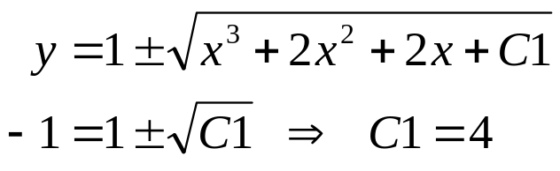
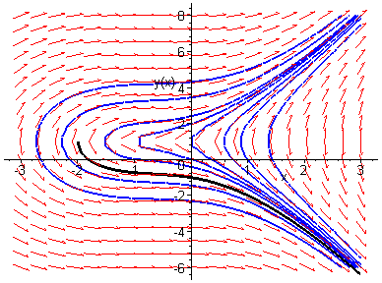

Example 2: Initial Value Problem (2 of 4)
Suppose we seek a solution satisfying y(0) = -1. Using the implicit expression of y, we obtain
Thus the implicit equation defining y is
Using explicit expression of y,
It follows that

Slide 5
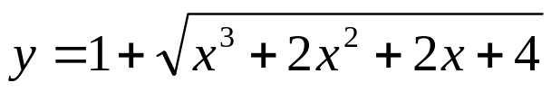
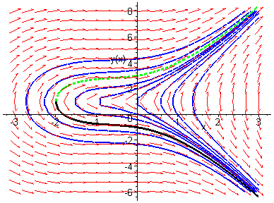
Example 2: Initial Condition y(0) = 3 (3 of 4)
Note that if initial condition is y(0) = 3, then we choose the positive sign, instead of negative sign, on square root term:

Slide 6
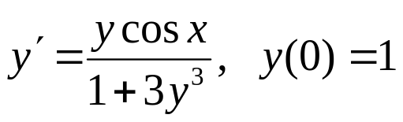
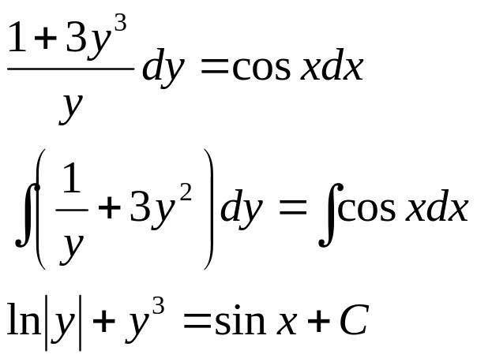

Example 3: Implicit Solution of Initial Value Problem (1 of 2)
Consider the following initial value problem:
Separating variables and using calculus, we obtain
Using the initial condition, it follows that

Slide 7
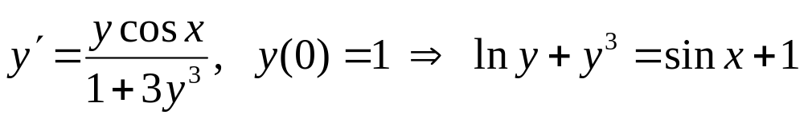
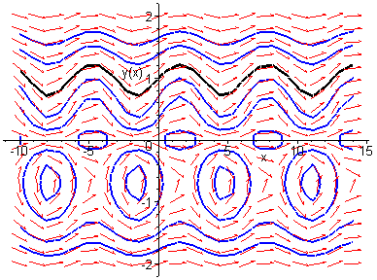
Example 3: Graph of Solutions (2 of 2)
Thus
The graph of this solution (black), along with the graphs of the direction field and several integral curves (blue) for this differential equation, is given below.

